Slide 1
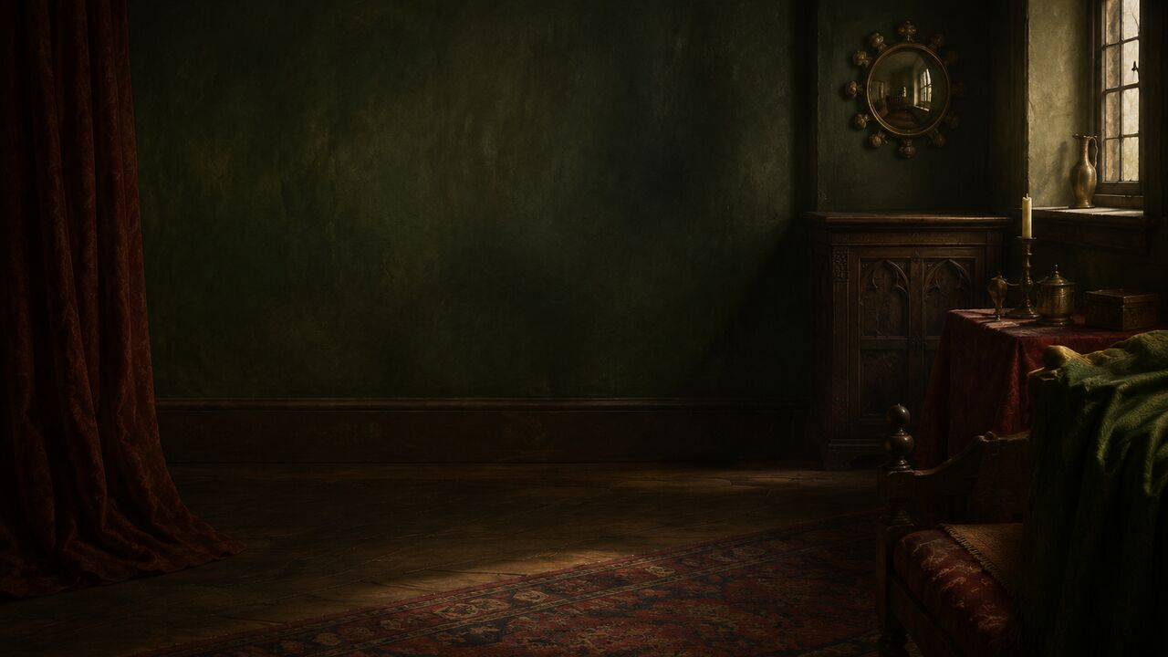
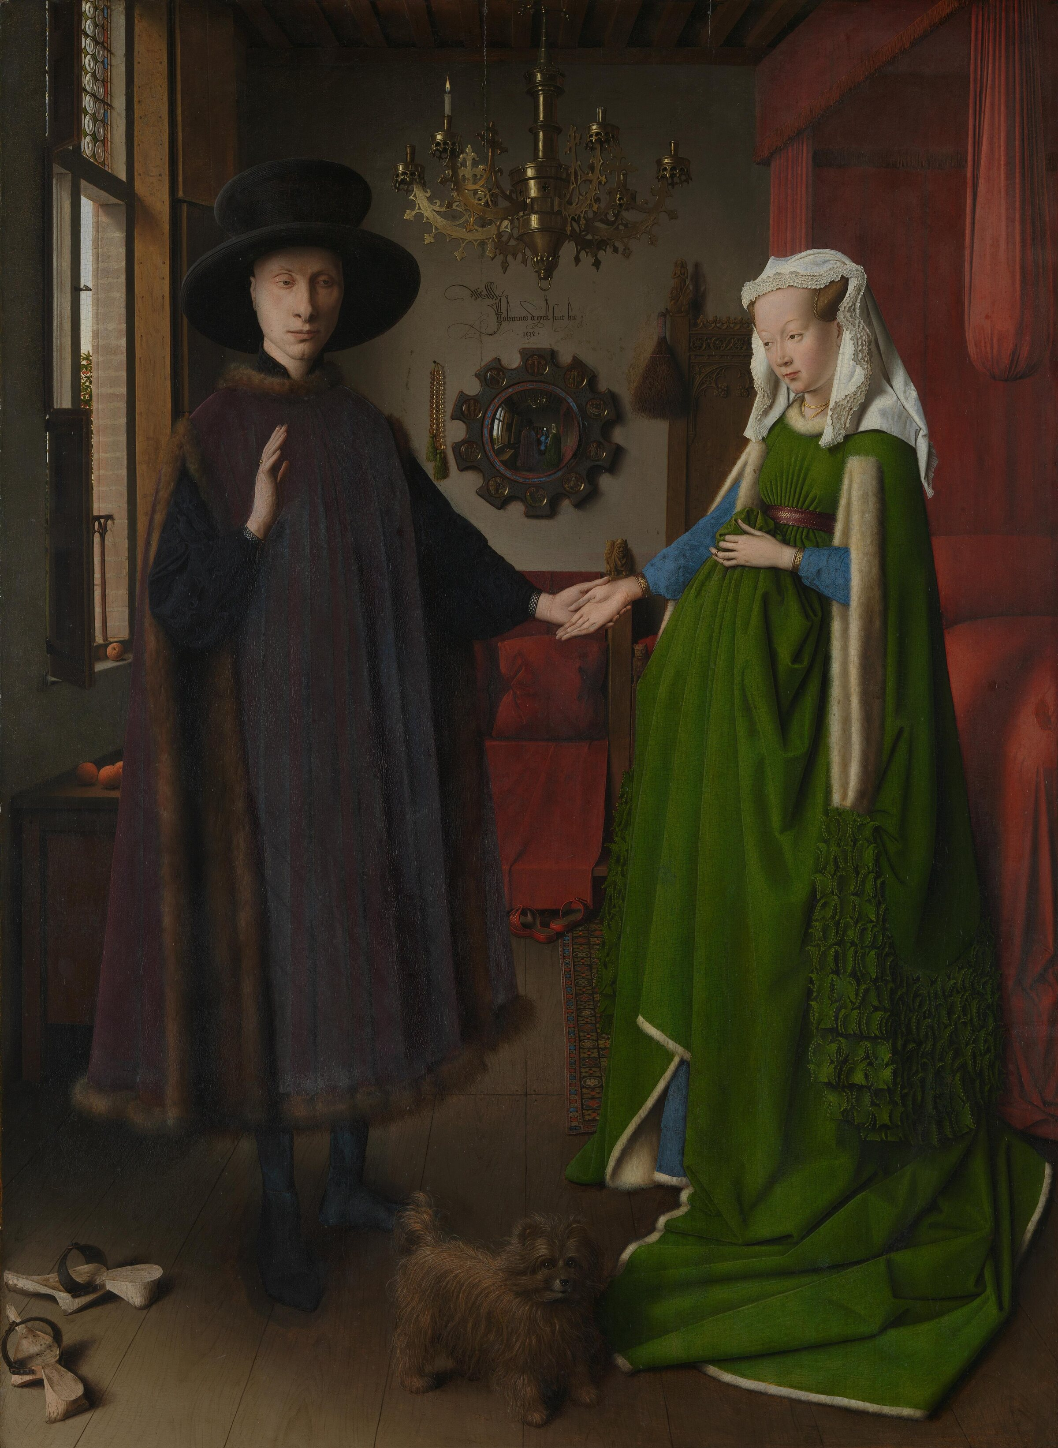
MASTERS & MASTERPIECES | JAN VAN EYCK | 1434
Not a Wedding?
Not Pregnant?
The real mystery of the Arnolfini Portrait
Set aside three familiar answers: wedding, pregnancy, symbolic code.
MASTERS & MASTERPIECES
Notes:
You may know this painting through three famous answers: it records a wedding, the woman is pregnant, and the dog, candle, oranges, and shoes are all symbols of marriage.
For the next few minutes, set those answers aside. We have no reliable evidence that a wedding is taking place. The woman's raised silhouette does not prove pregnancy. Even more surprisingly, the dog, chandelier, beads, chair, and discarded shoes—some of the painting's most famous details—do not appear in the currently visible initial underdrawing.
And this room, so convincing that it feels almost photographic, may never have existed in this exact form.
In 1434, Jan van Eyck created a world on a relatively small oak panel that viewers have not finished examining nearly six centuries later. The best question is not simply, “What does every object mean?” It is: how did he make a selected, altered, and staged world feel more real than reality?
[Sources]
- https://www.nationalgallery.org.uk/paintings/jan-van-eyck-the-arnolfini-portrait
- https://www.nationalgallery.org.uk/paintings/catalogues/campbell-1998/the-arnolfini-portrait

Slide 2
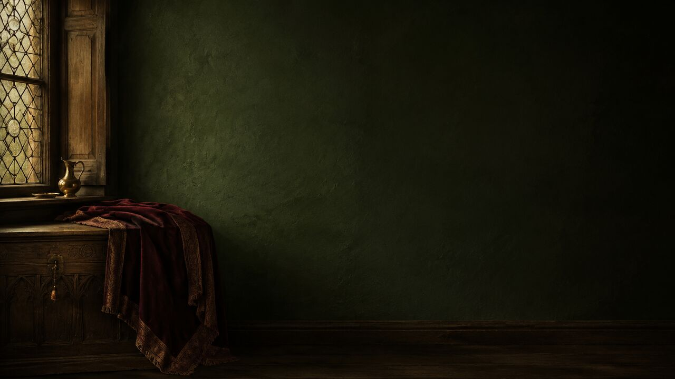
MASTERS & MASTERPIECES | JAN VAN EYCK | 1434
02
A Double Portrait Filled with Questions
OBJECT DATA
Date: 1434
Medium: oil on oak
Collection: The National Gallery, London
QUESTIONS INSIDE THE ROOM
Who are they? Why is the man's hand raised?
Why are two visitors in the mirror?
Why write ‘I was here’?
82.2 × 60 cm | Oil on oak | National Gallery, London, NG186
MASTERS & MASTERPIECES
Notes:
The *Arnolfini Portrait* is in London's National Gallery, accession number NG186. It was painted in oils on oak in 1434 and measures about 82.2 by 60 centimetres. Its physical scale is modest, but its visual information is extraordinary.
A man stands near the window in a dark robe and broad hat. A woman in a brilliant green gown stands before a red bed. Their hands meet at the center, while a small dog occupies the foreground. Light enters from the left and moves across oranges, a brass chandelier, beads, discarded shoes, and a tiny convex mirror.
The scene appears to explain everything, yet almost every detail creates another question. Who are these people? Why does the man raise his hand? Why do two more figures appear in the mirror? And why did van Eyck write not “I painted this,” but “I was here”?
[Sources]
- https://www.nationalgallery.org.uk/paintings/jan-van-eyck-the-arnolfini-portrait

Slide 3
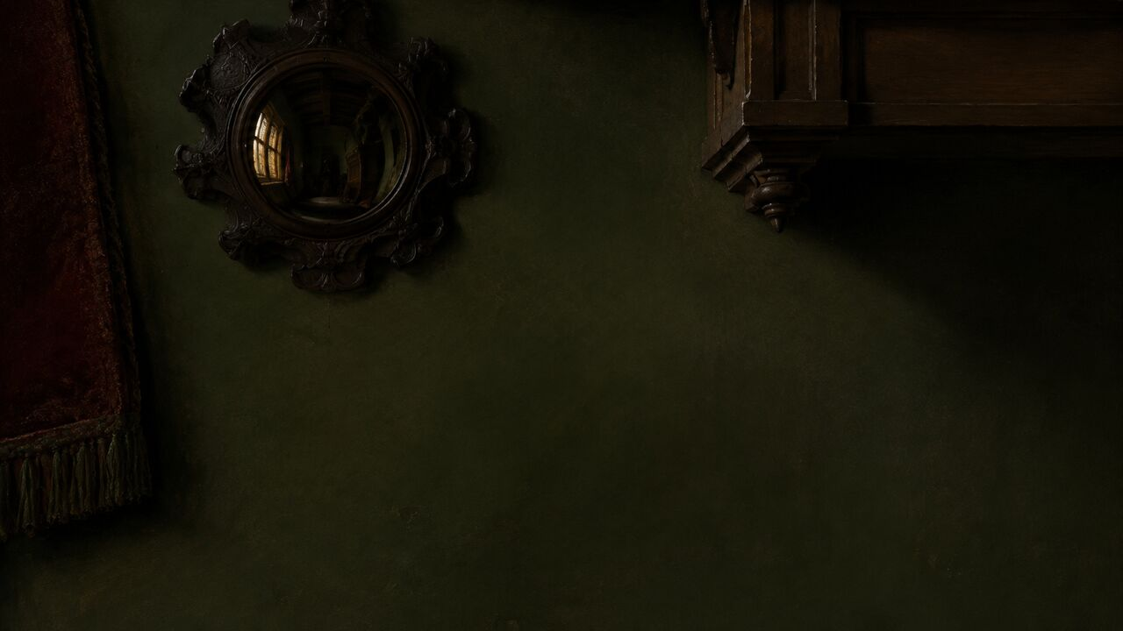
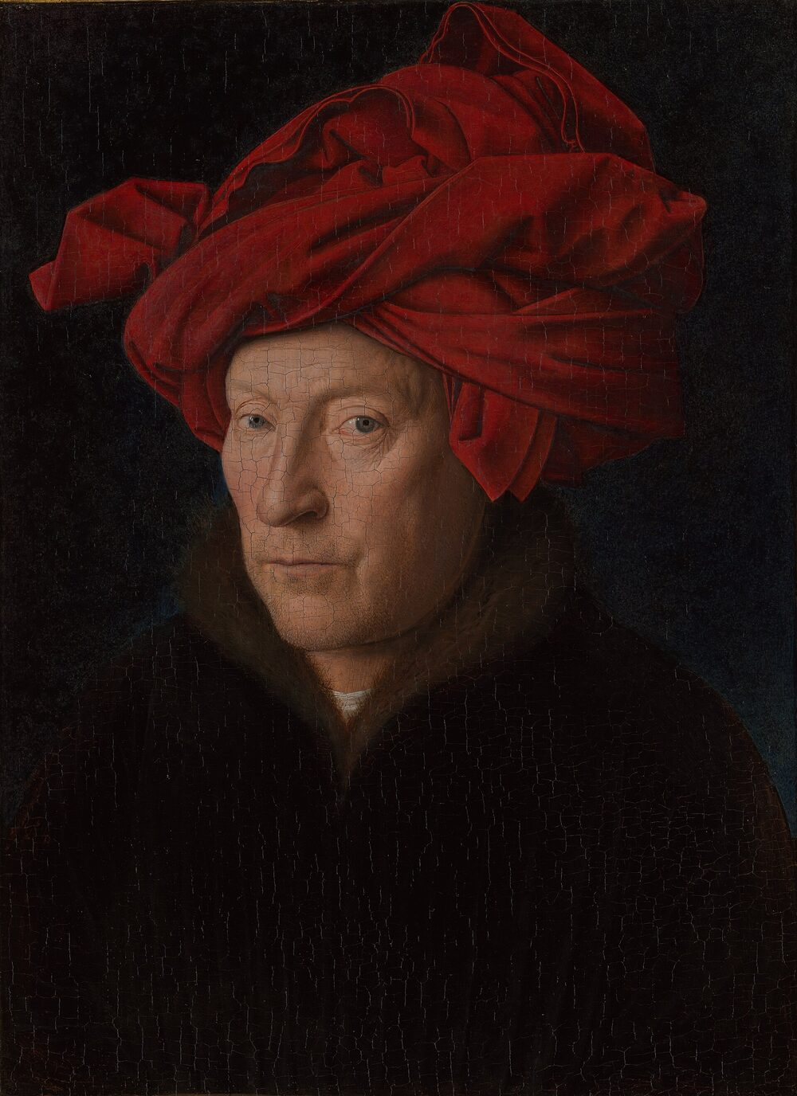
MASTERS & MASTERPIECES | JAN VAN EYCK | 1434
03
Bruges in 1434: Merchants Meet the Court
BRUGES
LUCCA
COMMERCE × COURT × DIPLOMACY
ENGLAND
PORTUGAL
Bruges linked court culture, banking, textiles, and international merchants.
MASTERS & MASTERPIECES
Notes:
To understand the room, return to fifteenth-century Bruges. Under Burgundian rule, the city connected English wool, Flemish textiles, Italian banking, North Sea shipping, luxury goods, and an ambitious court. It was one of Europe's great international commercial centers.
The Arnolfini family came from Lucca and participated in this northern trading world. Van Eyck occupied a different but intersecting social position. From 1425 he served Philip the Good, Duke of Burgundy, as court painter and *valet de chambre*. He undertook journeys and diplomatic assignments. In 1428 he travelled to Portugal as part of the duke's marriage negotiations and produced a portrait of Isabella of Portugal.
The painting therefore stands where two worlds meet: the refined visual culture of the Burgundian court and the growing wealth of international merchants. The room looks private, but it is also a stage on which identity becomes visible.
[Sources]
- https://www.nationalgallery.org.uk/paintings/jan-van-eyck-the-arnolfini-portrait
- https://www.nationalgallery.org.uk/paintings/catalogues/campbell-1998/the-arnolfini-portrait

Slide 4
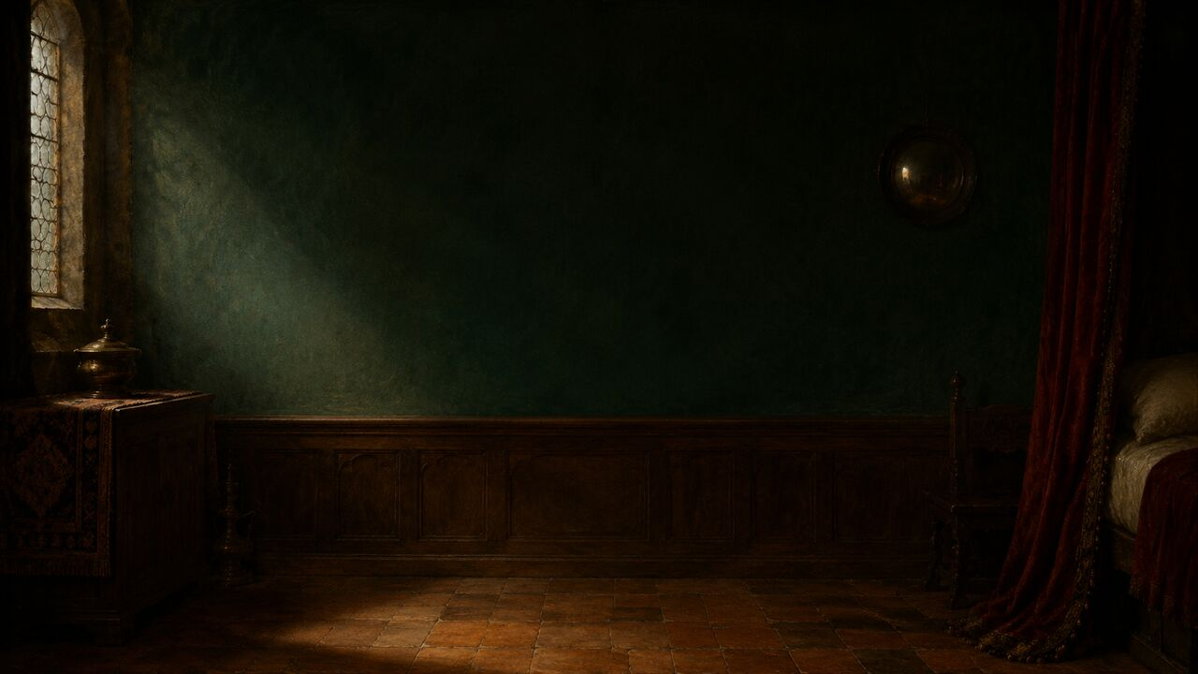
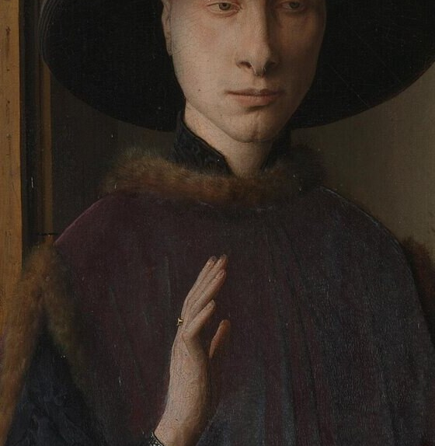
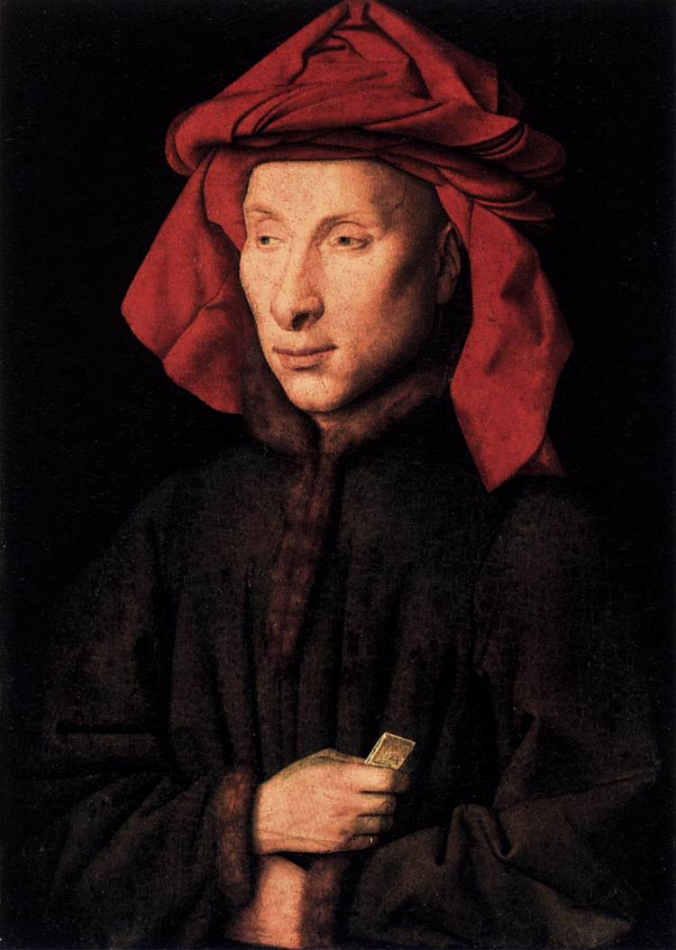
MASTERS & MASTERPIECES | JAN VAN EYCK | 1434
04
Who Are the Couple?
THE MAN
Man: likely, not certain
THE WOMAN
Woman: unidentified
The old 1447 wedding theory fails
The man is probably Giovanni di Nicolao; the woman remains unknown.
MASTERS & MASTERPIECES
Notes:
The National Gallery currently considers Giovanni di Nicolao di Arnolfini, an Italian merchant based in Bruges, the most likely identity of the man. The attribution is plausible, not absolute. The woman remains unidentified.
An older theory named the couple as Giovanni di Arrigo Arnolfini and Giovanna Cenami. Documents show, however, that they married in 1447—thirteen years after the painting and after van Eyck's death. That identification is no longer sustainable.
Berlin holds a later portrait by van Eyck of a more simply dressed, older man whose facial features closely resemble the London sitter. This provides an important visual argument for Giovanni di Nicolao. It does not identify the woman. She may have been a presumed second wife, although even that marriage lacks direct documentation. A minority memorial theory connects the image with his first wife, Costanza Trenta, who died around 1433, but this too remains unproved.
[Sources]
- https://www.nationalgallery.org.uk/paintings/jan-van-eyck-the-arnolfini-portrait
- https://www.nationalgallery.org.uk/paintings/catalogues/campbell-1998/the-arnolfini-portrait

Slide 5
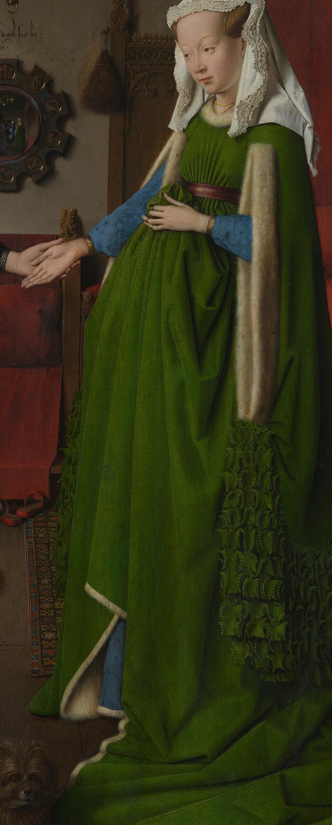
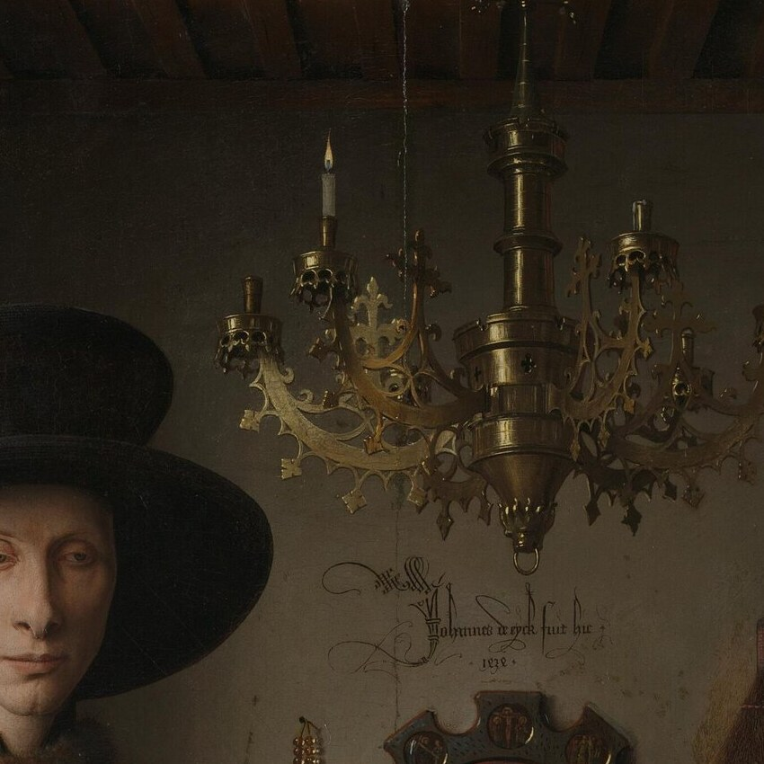
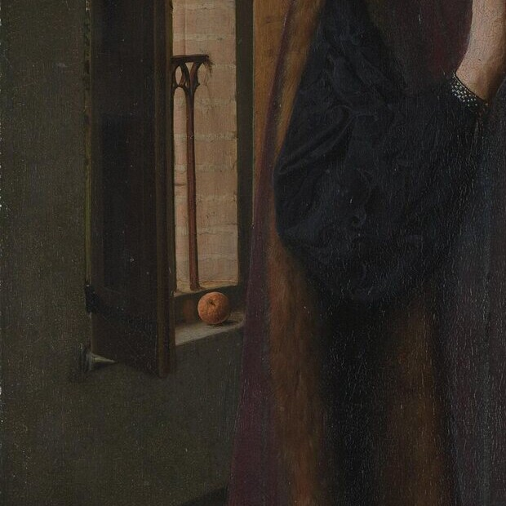
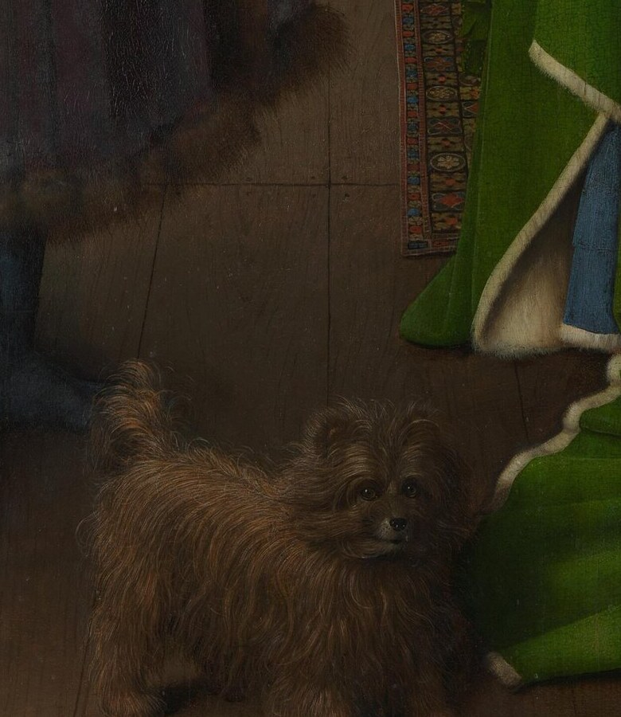
MASTERS & MASTERPIECES | JAN VAN EYCK | 1434
05
Van Eyck Did Not Invent Oil Painting
GREEN FABRIC
BRASS
ORANGE & WOOD
FUR & SHADOW
Van Eyck did not invent oil painting—he transformed light and matter.
MASTERS & MASTERPIECES
Notes:
Van Eyck is still sometimes credited with inventing oil painting. Oil-based media existed before him. His achievement was to exploit their transparency, drying behavior, and capacity for layered glazes with exceptional control.
Look at how the man's dark clothing absorbs light and how the fur edge feels soft and dense. Light slides across the woman's green folds. Brass reflects it; glass transmits it; orange peel appears slightly rough. Wood, skin, hair, and fabric each respond differently.
Van Eyck did not merely paint objects. He painted what light does when it meets different materials. National Gallery technical research even records a thumbprint in the paint near the dog's leg, where he adjusted the shadow with his hand. More than five centuries later, the panel preserves not only the written claim “I was here,” but a physical trace of the painter's touch.
[Sources]
- https://www.nationalgallery.org.uk/paintings/jan-van-eyck-the-arnolfini-portrait

Slide 6
MASTERS & MASTERPIECES | JAN VAN EYCK | 1434
06
The Most Realistic Room May Never Have Existed
CONVINCING DETAILS
Light, wood, glass, fur, and cloth
AN INCONSISTENT WHOLE
Space for the chandelier?
A short bed and oversized mirror?
Summer cherries × heavy fur
Realism is not photography. It is construction.
The convincing room is also a carefully constructed impossibility.
MASTERS & MASTERPIECES
Notes:
The room is so persuasive that van Eyck seems to have removed a wall and copied the space beyond. Close inspection reveals contradictions.
There may not be enough room for the chandelier. The bed appears too short. The convex mirror seems implausibly large for the period. There is no visible fireplace. A fruiting cherry tree beyond the window suggests a warmer season, yet both figures wear heavy fur-trimmed clothing.
Nor is this necessarily a private bedroom in the modern sense. The National Gallery describes it as a reception room. In a wealthy fifteenth-century house, an elaborate bed could occupy a public-facing space because it was among the household's most expensive status objects.
Van Eyck may not have copied one existing interior. He adjusted proportions and combined things, then used intensely credible local details to persuade us to accept an inconsistent whole. Realism here is not photography. It is construction.
[Sources]
- https://www.nationalgallery.org.uk/paintings/jan-van-eyck-the-arnolfini-portrait
- https://www.nationalgallery.org.uk/paintings/catalogues/campbell-1998/the-arnolfini-portrait

Slide 7
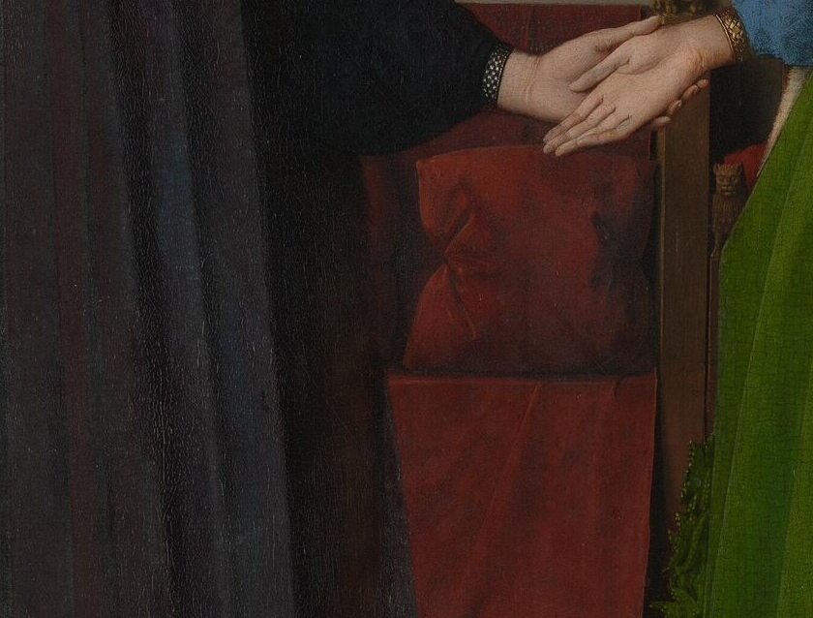
MASTERS & MASTERPIECES | JAN VAN EYCK | 1434
07
The Joined Hands and Panofsky's Wedding Theory
Gesture and oath
→
Reflected witnesses
→
fuit hic and presence
1934: PANOFSKY
An influential wedding-symbol system
Today: possible, but not proved
Marriage probably matters; a formal wedding cannot be proved.
MASTERS & MASTERPIECES
Notes:
The joined hands invite narrative. The man supports the woman's right hand with his left while raising his right. In 1934, Erwin Panofsky proposed one of art history's most influential interpretations: the picture records a marriage and functions as visual evidence of a contract.
Within his system, the joined hands signify consent, the raised hand an oath, the reflected figures witnesses, and van Eyck's “was here” inscription proof of attendance. The dog becomes fidelity, the candle divine presence, the shoes sacred ground, and the bed and Saint Margaret marriage and fertility.
The theory is compelling because it organizes every detail. Later scholarship weakened its legal claims. “Fuit hic” was not the normal witness formula in marriage documents. The inscription lacks a complete date and the identity of a second witness. Most importantly, the earliest reliable inventory of 1516 simply describes “Hernoul le Fin and his wife in a room.” It does not call the scene a wedding.
The cautious starting point today is a double portrait. Marriage probably matters, but a formal wedding on a specific day cannot be proved. The raised hand may even be a greeting to the visitors reflected in the mirror.
[Sources]
- https://www.nationalgallery.org.uk/paintings/catalogues/campbell-1998/the-arnolfini-portrait
- Erwin Panofsky, ‘Jan van Eyck's Arnolfini Portrait,’ The Burlington Magazine, 1934

Slide 8
MASTERS & MASTERPIECES | JAN VAN EYCK | 1434
08
Is She Pregnant?
DRESS STRUCTURE
Abundant fur-lined fabric
GESTURE
The train is lifted before the abdomen
THE PRECISE CLAIM
Fertility associations ≠ actual pregnancy
Her silhouette comes from dress structure and raised fabric, not proof of pregnancy.
MASTERS & MASTERPIECES
Notes:
Modern viewers often interpret the woman's silhouette as immediate evidence of pregnancy. Costume historians generally do not.
Her green gown contains a large quantity of fur-lined fabric. She raises its train in front of her abdomen, where the material gathers and projects outward. The gesture also displays the quantity and expense of the cloth and reveals layers of color beneath. Similar silhouettes appear in fifteenth-century images of women who are not being represented as pregnant.
“Pregnancy is not proved” does not mean fertility is irrelevant. The small carved figure behind her is usually identified as Saint Margaret, a patron associated with childbirth. Marriage also carried intense social expectations concerning lineage.
The most accurate formulation is therefore precise: her appearance is not reliable evidence of an actual pregnancy, but the clothing, gesture, and surrounding imagery may have encouraged contemporary viewers to think about future fertility within marriage.
[Sources]
- https://smarthistory.org/jan-van-eyck-the-arnolfini-portrait/
- https://www.nationalgallery.org.uk/paintings/jan-van-eyck-the-arnolfini-portrait

Slide 9
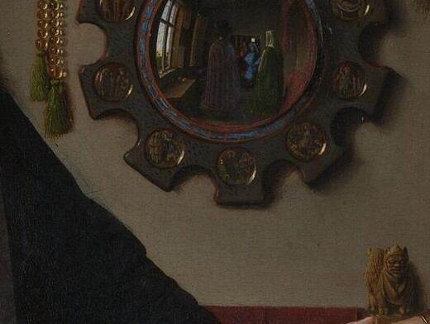
MASTERS & MASTERPIECES | JAN VAN EYCK | 1434
09
The Mirror Opens Another World
INSIDE THE MIRROR
Backs of the sitters
Two visitors beyond the picture
AROUND THE FRAME
Ten Passion scenes around the frame
VAN EYCK IN THE MIRROR? UNPROVED
The mirror brings two visitors—and the viewer's position—into the work.
MASTERS & MASTERPIECES
Notes:
The convex mirror is the painting's most astonishing visual device. Lorne Campbell estimated that the glass may be at least about twenty-eight centimetres in diameter—unusually large for a fifteenth-century convex mirror. The underdrawing once included an even larger octagonal frame.
Van Eyck may have enlarged it because the mirror had an almost impossible task. It reflects the backs of the couple, the window, the bed, and the opposite end of the room. It also introduces two visitors entering through a door beyond the viewer. A closed portrait suddenly opens into the space behind us.
Ten tiny scenes of Christ's Passion circle the frame. The glass reflects the room's present moment, while the frame contains sacred history. Everyday space and salvation history meet in one round object.
We cannot prove that the nearer reflected figure is van Eyck. The signature directly above the mirror makes that an attractive hypothesis, but not a confirmed self-portrait. What is certain is that the mirror turns the viewer's position into part of the work.
[Sources]
- https://www.nationalgallery.org.uk/paintings/catalogues/campbell-1998/the-arnolfini-portrait

Slide 10
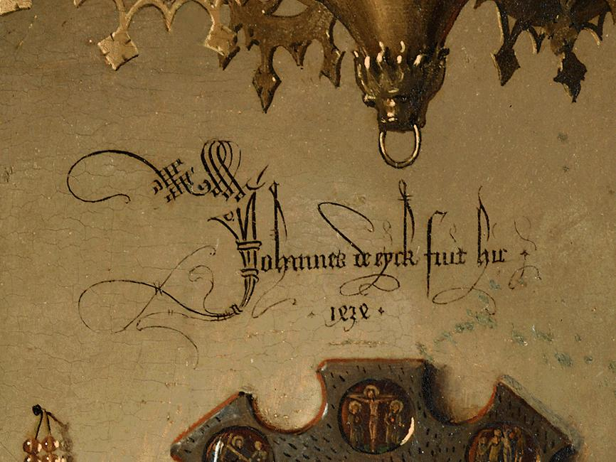
MASTERS & MASTERPIECES | JAN VAN EYCK | 1434
10
Jan van Eyck Was Here
Johannes de eyck
fuit hic. 1434.
JAN VAN EYCK WAS HERE.
Not an ordinary signature—a declaration of presence.
Johannes de eyck fuit hic. 1434 | Jan van Eyck was here.
MASTERS & MASTERPIECES
Notes:
Above the mirror is the inscription, “Johannes de eyck fuit hic. 1434”—“Jan van Eyck was here. 1434.”
This is not a discreet signature tucked into a frame. Written flamboyantly on the back wall, it becomes one of the room's objects. It does not merely say, “I made this.” It resembles graffiti, a traveler's mark, or a declaration of presence.
The phrase cannot prove that van Eyck witnessed a wedding. Yet inscription and mirror clearly reinforce each other. The words say that the painter was here; the mirror admits people from outside the visible scene.
Van Eyck was not an anonymous craftsman hidden behind the image. As a privileged court artist and *valet de chambre*, he occupied an unusual social position. The inscription asserts that this way of seeing—this orchestration of matter, light, space, and reflection—belongs specifically to Jan van Eyck.
[Sources]
- https://www.nationalgallery.org.uk/paintings/jan-van-eyck-the-arnolfini-portrait
- https://www.nationalgallery.org.uk/paintings/catalogues/campbell-1998/the-arnolfini-portrait

Slide 11
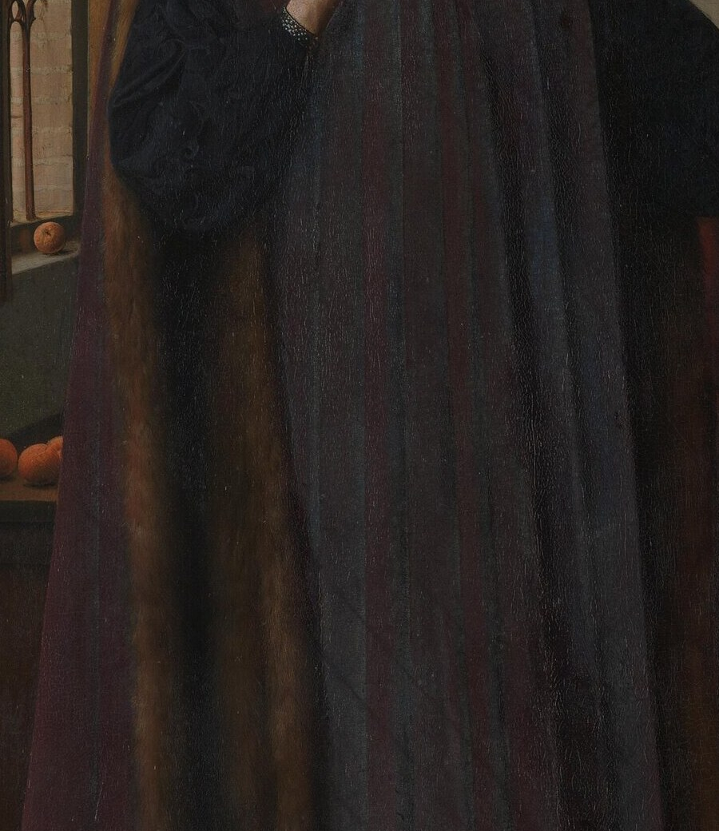
MASTERS & MASTERPIECES | JAN VAN EYCK | 1434
11
Oranges, Fur, and a Portrait of International Trade
ORANGES | IMPORT
FUR | STATUS
BRASS | CRAFT
TEXTILE | WEALTH
Wealth is not a list of objects. It is an environment.
Wealth appears not as coins, but as a complete material environment.
MASTERS & MASTERPIECES
Notes:
The painting is also a portrait of international trade. Wealth appears not as coins or account books, but as an environment.
The abundance of cloth and fur, red bed hangings, carpet, carved furniture, and brass chandelier required substantial resources. Oranges are ordinary to many viewers today. In fifteenth-century northern Europe, they were expensive imports from the south. The Arnolfini family came from Lucca and belonged to commercial networks joining Italian and northern cities.
Identity is therefore expressed not only through name, heraldry, or title, but through clothing, interior design, imported goods, and lifestyle. The logic remains familiar: where people live and what they own become part of how others read them.
Van Eyck's social intelligence lies in making wealth look natural. The room is not piled with treasure. Expensive things sit quietly, as though this level of comfort required no explanation.
[Sources]
- https://www.nationalgallery.org.uk/paintings/catalogues/campbell-1998/the-arnolfini-portrait
- https://smarthistory.org/jan-van-eyck-the-arnolfini-portrait/

Slide 12
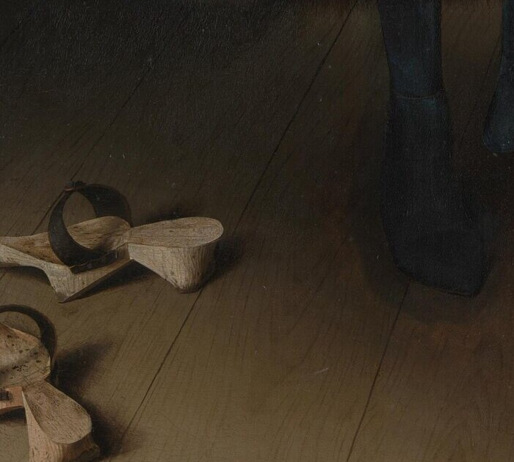
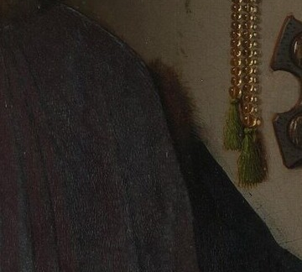
MASTERS & MASTERPIECES | JAN VAN EYCK | 1434
12
Does One Candle Have One Answer?
DOG
SHOES
BEADS
ORANGES
CANDLE
fidelity / pet / status
sacred / ordinary
devotion / precious object
religion / trade / wealth
presence / life / death
OBJECT → OVERLAPPING MEANINGS
Objects do not equal one answer; meanings can overlap.
MASTERS & MASTERPIECES
Notes:
The chandelier's single burning candle has been read as God's presence, a sacred witness to marriage, or a contrast between life and death. Such associations have historical contexts, but none can be demonstrated as the one exclusive meaning.
The dog can evoke fidelity and also function as an expensive pet. Discarded shoes can recall sacred ground and remain ordinary household behavior. Beads are devotional tools and precious possessions. Oranges can carry religious associations and most directly advertise wealth and long-distance exchange.
Fifteenth-century objects could operate practically, socially, religiously, and symbolically at the same time. A better question is not, “What single word does this object translate into?” It is, “What range of associations could this object activate?”
Once the fixed codebook disappears, the painting does not become meaningless. It becomes a more historically plausible environment in which meanings overlap.
[Sources]
- https://www.nationalgallery.org.uk/paintings/catalogues/campbell-1998/the-arnolfini-portrait

Slide 13
MASTERS & MASTERPIECES | JAN VAN EYCK | 1434
13
The Painting Changes Under Infrared Light
INITIAL DESIGN
ADDED WHILE PAINTING
FINISHED IMAGE
Underdrawing: figures, furniture, architecture
Added while painting: dog, chandelier, shoes, beads
The sitters also changed
→
→
ADDED DURING PAINTING ≠ LATER RESTORATION
Added during painting ≠ later restoration: the image records decisions.
MASTERS & MASTERPIECES
Notes:
Infrared reflectography shows that van Eyck did not design every famous detail at the start and then mechanically fill it in.
The initial underdrawing established the figures, principal furniture, and basic architecture. The dog, chandelier and candle, chair, beads, and discarded shoes are absent from the currently visible early design and were introduced later in the painting process. Smaller objects such as the oranges also lack corresponding underdrawing.
The people changed too. The man's original face was larger, his hat bigger, his robe shorter, and his feet differently placed. The woman originally turned more toward him, and her face sat lower.
These things were not added centuries later by another hand. Van Eyck reconsidered the composition as he worked. The dog fills the foreground; the chandelier anchors the upper space; shoes and beads enrich the lived environment. We cannot document why he made each decision.
This complicates the idea of a complete symbolic marriage program fixed from the beginning. Deliberate addition does not give us a single meaning. What the infrared evidence gives us is something better: the painting as a sequence of artistic choices.
[Sources]
- https://www.nationalgallery.org.uk/paintings/jan-van-eyck-the-arnolfini-portrait
- https://www.nationalgallery.org.uk/paintings/catalogues/campbell-1998/the-arnolfini-portrait

Slide 14
MASTERS & MASTERPIECES | JAN VAN EYCK | 1434
14
Five Centuries of Collection and Reinterpretation
1434
1516
1842
1934
TODAY
Completed
Inventory
National Gallery
Wedding theory
Technical research
The panel remains. The questions change.
Each generation revises the painting through new evidence.
MASTERS & MASTERPIECES
Notes:
The earliest securely known owner was Don Diego de Guevara, who gave the painting to Margaret of Austria. Her 1516 inventory describes “Hernoul le Fin and his wife in a room.”
Early records also mention closable wings or shutters bearing Guevara's arms. Those elements have disappeared. The object we see in the National Gallery may not look exactly as it did to a sixteenth-century viewer.
The painting later entered Spanish collections and reached Britain in the nineteenth century. The National Gallery acquired it in 1842 for 600 guineas. Viewers once guessed that the man was reading the woman's palm. Panofsky built his marriage theory in 1934. Technical imaging, costume history, and material-culture research now test those older answers.
The panel remains materially similar, but the questions brought before it change. Art history is not the memorization of a final solution. It is the discipline of revising the best explanation when better evidence appears.
[Sources]
- https://www.nationalgallery.org.uk/paintings/jan-van-eyck-the-arnolfini-portrait
- https://www.nationalgallery.org.uk/exhibitions/past/reflections-van-eyck-and-the-pre-raphaelites

Slide 15
MASTERS & MASTERPIECES | JAN VAN EYCK | 1434
15
How to Look at It Today
01 FIGURES
Begin with the figures' quiet
02 HANDS
Notice the joined hands
03 LIGHT
Follow the light from the left
04 MIRROR
Open the space behind us
05 INSCRIPTION
Read the painter's presence
Could the nearer visitor be van Eyck?
Figures → hands → light → mirror → inscription: follow the viewing route.
MASTERS & MASTERPIECES
Notes:
If you stand before this painting at the National Gallery, do not begin by hunting for proof of a wedding or pregnancy.
Begin with the two figures and their strange quiet. Notice how the joined hands connect the two halves of the composition. Follow the green folds down to the floor, then return to the man's dark clothing, which nearly swallows the light.
Next, follow the illumination from the left window. It touches oranges, faces, white linen, and brass before entering the mirror. Move close to that reflection and the closed room opens behind you. You are no longer simply looking at a couple. You occupy the position of figures beyond the painted field.
Finally, read: “Jan van Eyck was here.” Van Eyck is not proving that painting can copy the world like a camera. He is showing that it can hold front and back, presence and reflection, people and viewers, matter and meaning at once.
The painting's real mystery is not that an object lacks a fixed translation. It is that a chosen, altered, and arranged world remains more convincing than ordinary reality nearly six hundred years later.
Do you think the nearer figure in the mirror could be van Eyck? Share your reasoning in the comments.
[Sources]
- https://www.nationalgallery.org.uk/paintings/jan-van-eyck-the-arnolfini-portrait

Slide 16
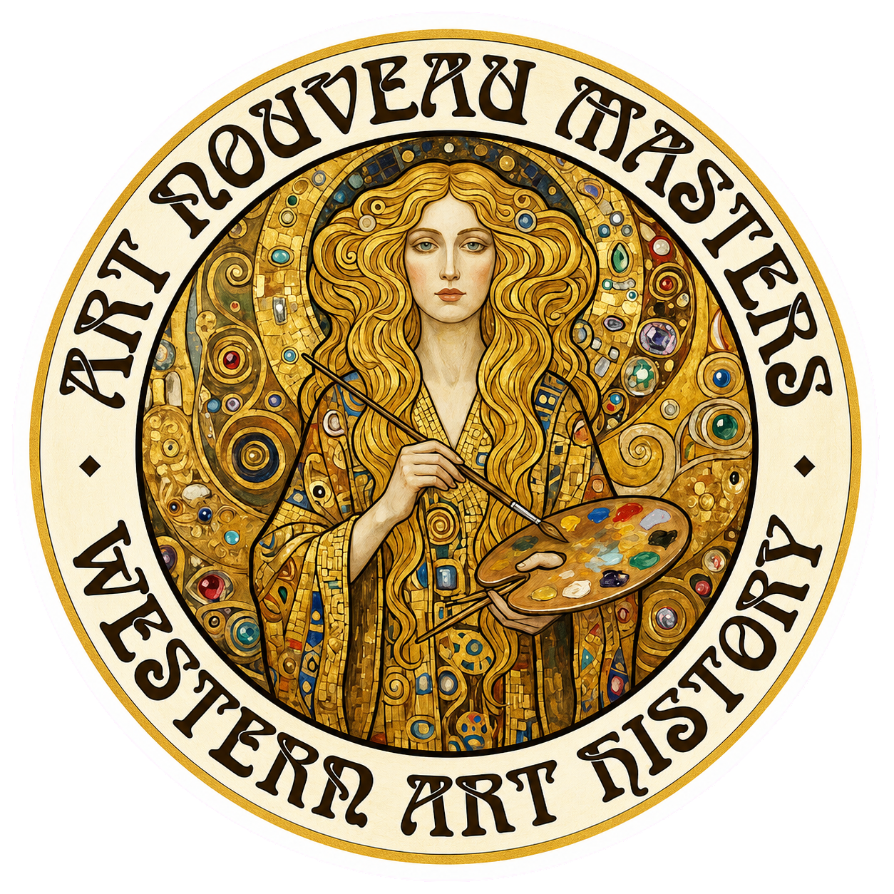
Notes:
This is Masters and Masterpieces. If you enjoy evidence-led ways of looking at great art, subscribe, share, and join us for the next work.
[Sources]
- Channel end card; no external sources.

